Slide 1

CARING HEART
CORONARY IMAGING
CARDIAC PET
BUSINESS PROPOSAL
March, 2010
Licensed to practice July 23, 2011
in New Jersey
Notes:
Name change??
Font??

Slide 2
WHAT IS
CARING HEART CORONARY IMAGING?
State of the Art Technology
Dedicated Cardiac PET System
Turnkey Imaging Resource

Slide 3
CARING HEART CORONARY IMAGING
Turnkey Imaging Resource Providing:
Insurance PreAuth & Follow-up
Patient scheduling & prep
System maintenance & QC
Scanning, licensing, accreditation
Staffing & Administration
Report filing & Archiving

Slide 4
SPECT CARDIOLOGY VS Caring Heart Coronary
Practices Imaging
  State of the Art Technology
  Dedicated Cardiac PET System
  Turnkey Resource
  Professional Reimbursement
GAIN $3,000.
  Decreased reimbursements
  Overhead
  Decreased Isotope supply
  LOSS $1,200
  (based upon 10 PET scans/day)

Slide 5
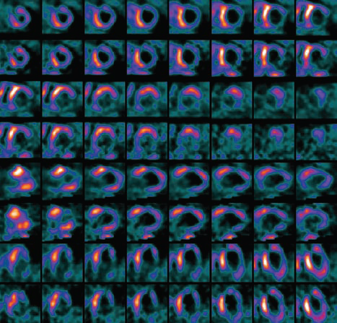
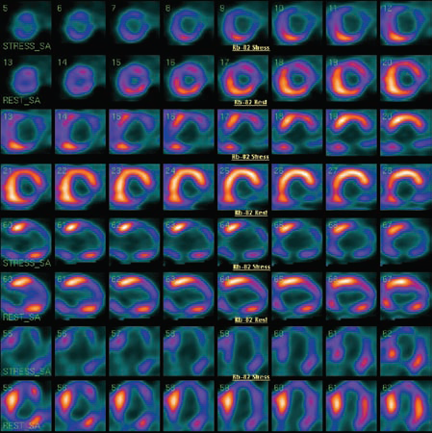
Old Technology PET Technology
CORONARY IMAGING
Equivicol Diagnosis
Resultant Catherizations
4 Hour Study
Accurate Diagnosis
Reduced Catherizations
1 Hour Study

Slide 6
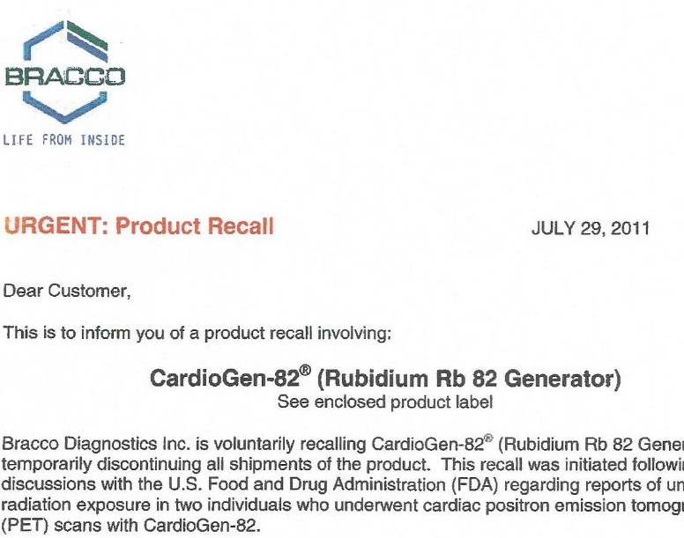
JULY 29,2011
FDA SHUTS DOWN ONLY RB-82 PROVIDER

Slide 7
Alzheimer’s Disease Epidemic
According to the Alzheimer’s Association, approximately four million Americans suffer from Alzheimer’s disease.
Every 70 seconds another patient is diagnosed with Alzheimer’s Disease.
And almost every 35 seconds someone is diagnosed with MCI (Mild Cognitive Impairment).
Alzheimer’s Disease affects almost 50 percent of all people 85 and older.

Slide 8
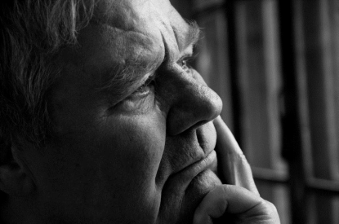
Caring Heart Coronary Imaging
Can Help Diagnose Alzheimer’s Disease
Caring Heart & Brain Imaging is proud
to provide noninvasive, neurological testing to help diagnose Alzheimer’s disease and dementia

Slide 9
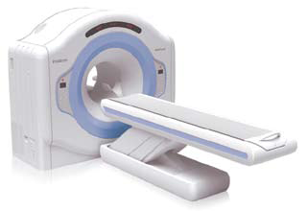
CARING HEART AND BRAIN IMAGING
We are the first in the state of NJ to have the Attrius scanner
CHCI also has the newest software technology in Neuroimaging
• Reduced Exposure - the Attrius scanner reduces patient exposure because there is no CT exposure.
• Improved Images - PET provides clearer, more precise 2D images better suited for detection of disease.
• Expert Analysis - Either our staff Nuclear Specialist
or your Nuclear Cardiologist, or can read your study.

Slide 10
The Best Weapon to Combat Alzheimer’s Disease - Early Detection
Caring Heart & Brain Imaging
GIVES FAMILIES HOPE BY PROVIDING:
PET (Positron Emission Tomography) Imaging
Highly precise scanning
Most accurate images
Differentiation between Alzheimer’s disease and fronto-temporal disease

Slide 11
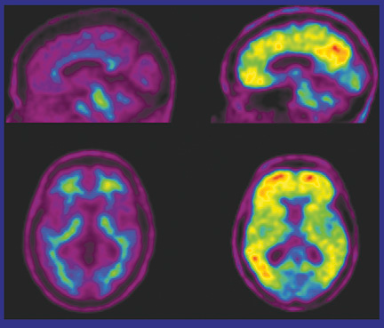
Memory Loss Images:
No PLAQUE present
plaque present
Alzheimer’s 2 yrs. Later

Slide 12
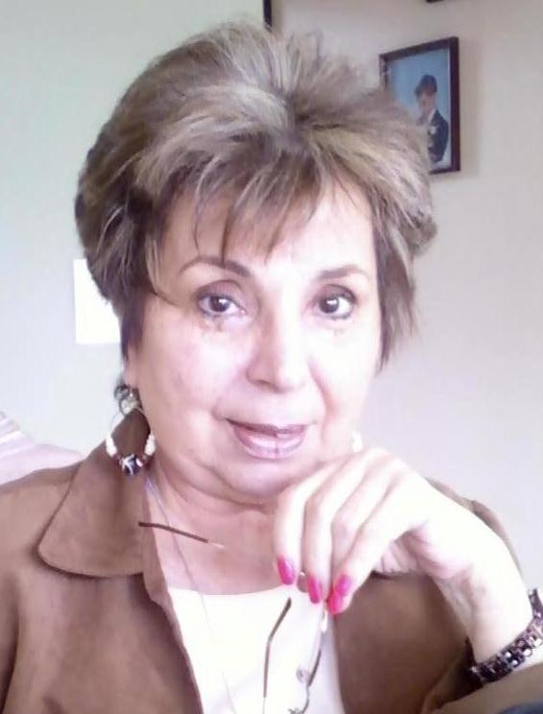
CARING HEART & BRAIN
IMAGING TEAM
Anthony DeLuca, MD
Medical Consultant
Lorraine Catalano, CNMT
Imaging Director
Debbie Schneider
Administrative Director
Lillian Hogan
Asst. Admin. Director
For over 20 years, Dr. DeLuca has been providing exceptional family care to Jersey Shore residents. He completed his residency at Jersey Shore Medical Center & is Board Certified in Internal Medicine.
He, along with his partner Lorraine Catalano, is proud to bring Caring Heart & Brain Imaging to the community.
Lorraine is a Certified Nuclear Medicine Technologist (CNMT) who is a member of the American Registry of Radiologic Technologists (ARRT)). Lorraine and her partner, Dr. Anthony DeLuca, are the brains behind the startup and operation of CARING HEART CORONARY IMAGING.
Debbie studied at Adelphi University in Long Island and has a BBA in accounting.
As Administrative Director, Debbie directs all the facility procedures with expertise and compassion to ensure that Caring Heart & Brain Imaging’s commitment to patient care is maintained and fulfilled.
Lillian has over 20 years’ office work experience; 10 of those working in medical offices.
As Assistant Administrative Director, Lillian is Debbie’s right hand helping her accomplish all office duties and assuring the high level of care that Caring Heart & Brain Imaging is becoming well known for.

Slide 13
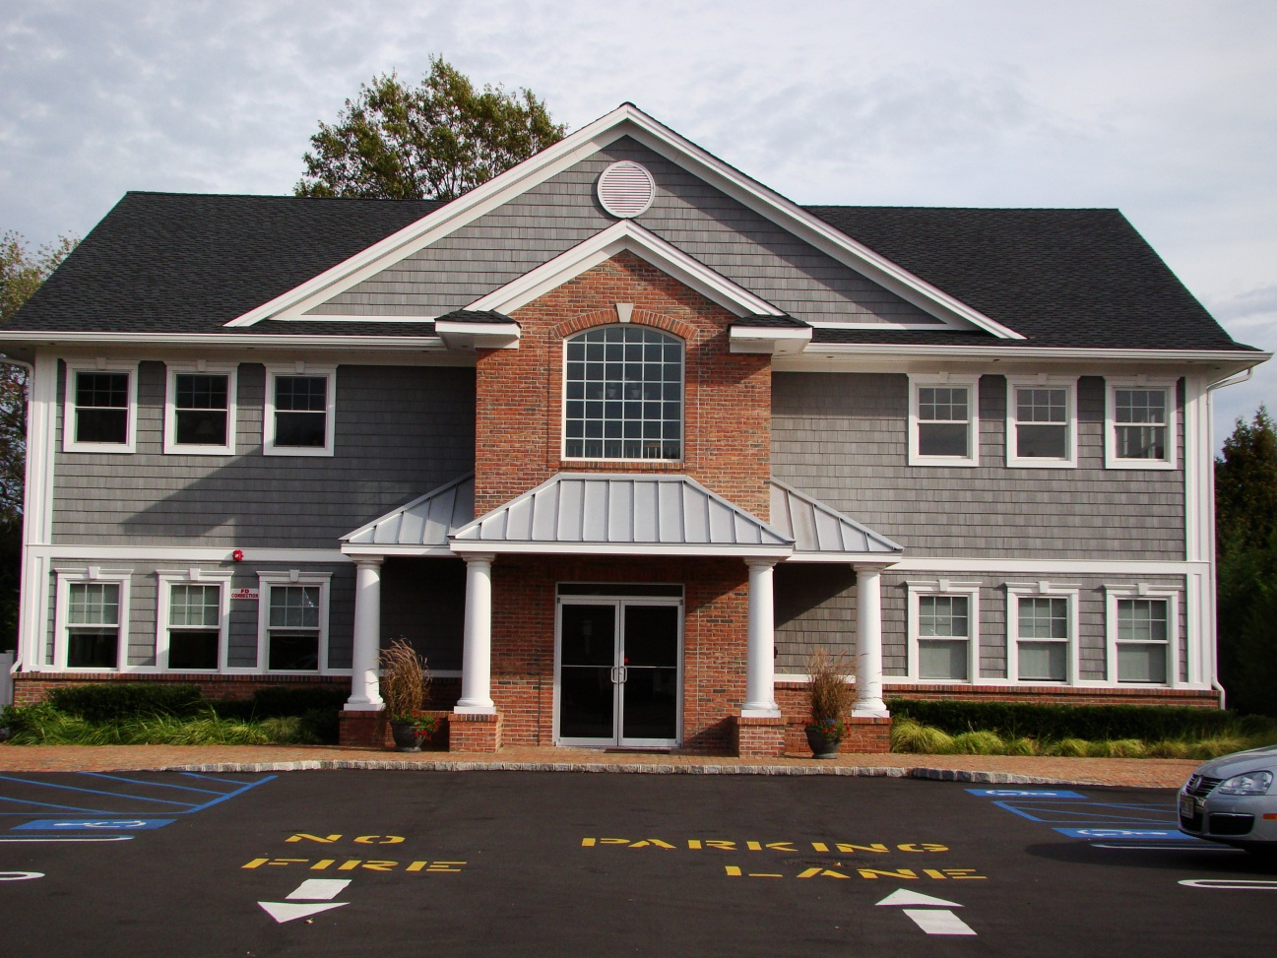
CARING HEART & BRAIN IMAGING
2414 Highway 35N
Manasquan, NJ 08736
732-292-1008

